Slide 1
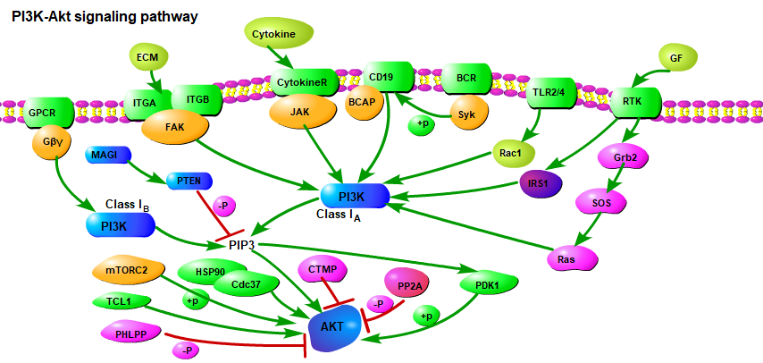




























PI3K-Akt signaling pathway
B cell receptor signaling pathway
Pathogen-associated
molecular patterns
(PAMPS)
Toll-like receptor
signaling pathway
JAK/STAT signaling pathway
Chemokine signaling pathway
Focal adhesion
Antigen
Hypoxia
LKB1
AMP
REDD1
Insulin signaling pathway
AMPK
TSC1
ErbB signaling pathway
AKT
TSC2
PI3K
+P
PI(4,5)P2
PTEN
PI(3,4,5)P3
Rheb
mTOR signaling pathway
+P
+P
GβL
+P
-P
Raptor
+P
+P
+P
+P
+P
+P
mTOR
+P
+P
+P
+P
+P
S6K1/2
4EBPs
+P
14-3-3
+P
+P
SGK
+P
+P
+P
+P
+P
+P
Raf-1
eNOS
PKCs
+P
+P
p21
VEGF signaling pathway
IKK
BAD
FOXO
+P
PKN
S6
eIF4B
eIF4E
CREB
p27
GSK3
MEK
MAPK signaling pathway
MDM2
RXRα
Bcl-xL
DNA
+P
NUR77
CDK
BRCA1
ERK
NO
Protein synthesis
NFκB
+P
Bcl-2
+P
DNA
DNA
DNA
DNA
Cyckin
+P
GYS
Glucose uptake Vesicle transport
Casp9
CCND1
Cell proliferation
Angiogenesis
DNA repair
p53
Bcl-2
PEPCK
Myc
Survival signal
Growth and proliferation
DNA
FasL
p27Kipl
G6Pace
Cell cycle
progression
Metabolism
Bcl-2
RBL2
Actin reorganization
Bcl-xL
Mcl-1
Bim
C-Myb
Cell
survival
Cell cycle
progression
Cell
survival
Metabolism
Cell
survival
Cell
survival
Cell cycle
progression
Glycolysis /
Gluconeogenesis
Cell
survival
Cell
survival
Apoptosis

Slide 2
PI3K-Akt signaling pathway
B cell receptor signaling pathway
Pathogen-associated
molecular patterns
(PAMPS)
Toll-like receptor
signaling pathway
JAK/STAT signaling pathway
Chemokine signaling pathway
Focal adhesion
Antigen
Hypoxia
LKB1
AMP
REDD1
Insulin signaling pathway
AMPK
TSC1
ErbB signaling pathway
AKT
TSC2
PI3K
+P
PI(4,5)P2
PTEN
PI(3,4,5)P3
Rheb
mTOR signaling pathway
-P
GβL
Raptor
+P
+P
mTOR
+P
+P
+P
14-3-3
+P
+P
S6K1/2
4EBPs
+P
+P
+P
SGK
+P
+P
+P
+P
+P
+P
Raf-1
eNOS
PKCs
+P
+P
p21
VEGF signaling pathway
IKK
BAD
FOXO
+P
PKN
S6
eIF4B
eIF4E
CREB
p27
GSK3
MEK
MAPK signaling pathway
MDM2
RXRα
Bcl-xL
DNA
+P
NUR77
CDK
BRCA1
ERK
NO
Protein synthesis
NFκB
+P
Bcl-2
+P
DNA
DNA
DNA
DNA
Cyckin
+P
GYS
Actin reorganization
Casp9
CCND1
Cell proliferation
Angiogenesis
DNA repair
p53
Bcl-2
PEPCK
Myc
DNA
FasL
p27Kipl
G6Pace
Cell cycle
progression
Glucose uptake Vesicle transport
Bcl-2
Metabolism
Bcl-xL
Mcl-1
Cell
survival
Bim
RBL2
Cell cycle
progression
Survival signal
Growth and proliferation
C-Myb
Cell
survival
Cell
survival
Metabolism
Cell
survival
Cell
survival
Cell cycle
progression
Glycolysis /
Gluconeogenesis
Cell cycle
progression
Cell
survival
Cell
survival
Apoptosis

Slide 3



+P
+P
+P
CoA
CoA

Slide 5



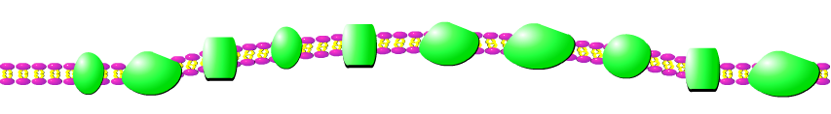







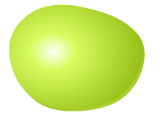





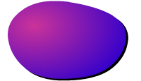


Estrogen signaling pathway
E2
βEnd
GABA
Ovarian
steroidogenesis
E2
HB-EGF
E2
MMP
Membrane-initiated steroid signaling
AC
μ
GIRK
GABAB
ER
mGluR1a
mER
EGFR
AC
(pro-)
HB-EGF
cAMP
OK⁺
Shc
cAMP
c-Src
Gq
PKCδ
Gi/o
c-Src
PKA
Gi/o
Grb2
Gα
Increase of
neuronal firing
(Proopiomelanocortin neuron )
PKA
Gβγ
E2
Ras
PI3K
PI3K-Akt signaling pathway
PLC
GABAergic synapse
SOS
Gs
DAG
IP3
Membrane-initiated steroid signaling
Akt
Ras
Raf
Ca²⁺
PI3K
GPER
+P
eNOS
IP3R
Raf
CAM
Akt
+P
ER
v
ER
MEK
NO
ER
MEK
+P
SNO
Cell survival
(cardiomyocyte,
neuron)
+P
Hsp90
calcium signaling pathway
+P
Nuclear-
initiated
steroid
signaling
ERK1/2
ERK1/2
FKBP52
Relaxation ( Vascular smooth muscle)
Cell survival
(Cardiomyocyte)
HAP70
Vascular
smooth muscle contraction
+P
+P
+P
pCREB
pCREB
ER
E2
ER
E2
+P
CoA
CoA
pCREB
DNA
DNA
TF
DNA
DNA
pCREB
DNA
TGFα
TFF1
KRT19
BCL2
DNA
RARα
PGR
CTSD
EBAG9

Slide 6
Estrogen signaling pathway
E2
βEnd
GABA
Ovarian
steroidogenesis
E2
HB-EGF
E2
MMP
Membrane-initiated steroid signaling
AC
μ
GIRK
GABAB
ER
mGluR1a
mER
EGFR
AC
(pro-)
HB-EGF
cAMP
OK⁺
Shc
cAMP
c-Src
Gq
PKCδ
Gi/o
c-Src
PKA
Gi/o
Grb2
Gα
Increase of
neuronal firing
(Proopiomelanocortin neuron )
PKA
Gβγ
E2
Ras
PI3K
PI3K-Akt signaling pathway
PLC
GABAergic synapse
SOS
Gs
DAG
IP3
Membrane-initiated steroid signaling
Akt
Ras
Raf
Ca²⁺
PI3K
GPER
+P
eNOS
IP3R
Raf
CAM
Akt
+P
ER
v
ER
MEK
NO
ER
MEK
+P
SNO
Cell survival
(cardiomyocyte,
neuron)
+P
Hsp90
calcium signaling pathway
+P
Nuclear-
initiated
steroid
signaling
ERK1/2
ERK1/2
FKBP52
Relaxation ( Vascular smooth muscle)
Cell survival
(Cardiomyocyte)
HAP70
Vascular
smooth muscle contraction
+P
+P
+P
pCREB
pCREB
ER
E2
ER
E2
+P
CoA
CoA
pCREB
DNA
DNA
TF
DNA
DNA
pCREB
DNA
TGFα
TFF1
KRT19
BCL2
DNA
RARα
PGR
CTSD
EBAG9

Slide 7
